Slide 1
how me the Money!
Grant and Award application tips
for businesses and community groups
Michael Thurston, General Manager, Destination North Coast
Stephanie Hunt, Economic Development Officer, LCC
DATE 9 October 2024
Say hello to your new 2014 Business document

Slide 2
Presentation
– Destination North Coast NSW

Slide 3
Public Funded Grants
& Tourism Awards

Slide 4
Tourism Awards
Applying for and ultimately succeeding with awards provides a variety of benefits to your organisation.
Proof of concept – to yourself and the market.
An opportunity to review and reflect on your business operations – What makes you different, efficient, effective…
An opportunity for you and your team to take stock and reflect on what you have achieved.
A variety of promotion opportunities to leverage.

Slide 5
Grants – The Process
Applying for grants can be time consuming and taxing but the process is valuable for your business;
Applying for grants provides operators with an opportunity to review their business plan and wider strategy – work on rather than in the business. Need to be ready before grants are announced.
This review of strategy is a good chance to reflect on process and alignment with local, regional and state strategies.
Once you have been successful once you are more likely to be successful moving forward. Builds credibility.

Slide 6
Grants - Benefits
Applying for and receiving public grants can greatly improve your businesses development and chances of success;
Enable you to secure funding to develop a concept, expand your operation, partner with other organisations
Demonstrate the strategic alignment with local, regional and state objectives
Can expedite the growth of your business
It provides an opportunity to have your business or concept reviewed. You may not always be successful, but it will provide an opportunity to receive feedback.
You will be incorporated into communication activity from the funding body that will increase awareness of your business.

Slide 7
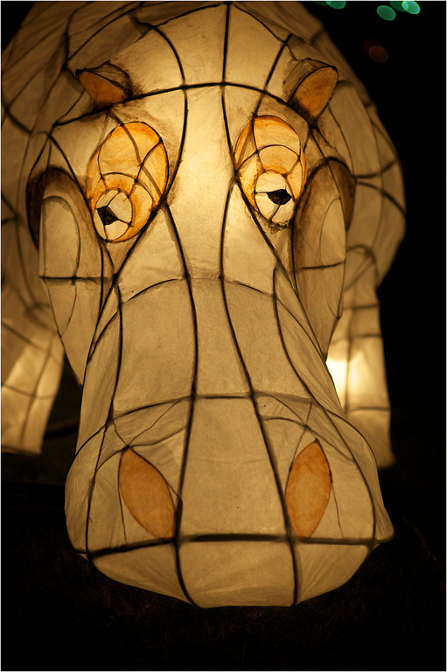
Grants – Types Available
There area wide variety of grants that come on offer;
Product development
Event funding
Aboriginal product and business support
EV charges
Sustainability, accessibility and inclusivity
Business resilience
Plus many more. There are a surprising amount of grants available covering many different aspects of operation or growth.

Slide 8
Thank you

Slide 9
Let’s talk about…
A few facts and figures
Top 5 things to consider before you apply
Strategy or Writer?
Passion!
How to find funding opportunities
Can we help? Yes, we can!
Bullet point one here. over one line but you can extend it if you wish.
Bullet point 2 here.
Bullet point 3 can go here.
Even more Bullet points can be added also.
Many businesses are operated through a separate entity such as a corporation or a partnership (either formed with or without limited liability). Most legal jurisdictions allow people to organize such an entity by filing certain charter documents with the relevant Secretary of State or equivalent and complying with certain other ongoing obligations.
Many businesses are operated through a separate entity such as a corporation or a partnership (either formed with or without limited liability).

Slide 10
Yes! There is funding available!
Did you know that last week there were:
1,855 grants worth $72.5B available nationally?
That included:
$62.6B worth of grants available for business, &
over 1,200 grants suitable for community.
Source: GRANTGURU website
1 October 2024
Source: GRANTGURU website
1 October 2024
Notes:
You just need to know where and how to look – we’ll cover this a bit later

Slide 11
More geese = more eggs
To help your business thrive, you need a diverse income stream:
Membership, donations, events – important aspects
Partnerships, earnings
Grants
planned projects / events can be bigger and better
‘wish-list’ projects can become realities
Bullet point one here. over one line but you can extend it if you wish.
Bullet point 2 here.
Bullet point 3 can go here.
Even more Bullet points can be added also.

Slide 12
Understanding
Government priorities
It is important to understand what Local, State and Federal Government priorities are.
Positioning your project around these will help to ensure alignment with funding program objectives.
Engage with politicians to gain support for your project.
Say hello to your new 2014 Business document
Notes:
TINA to explain

Slide 13
Let’s hear from you…
Why do YOU
need a grant?
Say hello to your new 2014 Business document
Notes:
Do a deeper dive around the room – use whiteboard – make notes

Slide 14
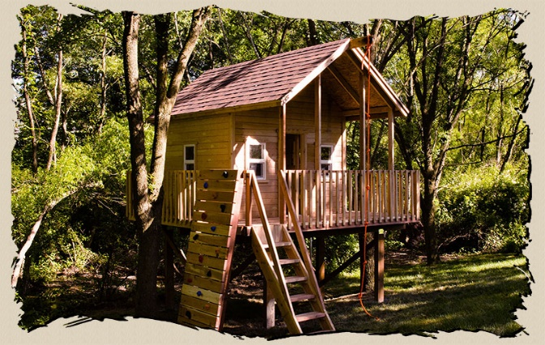
Why?
WHY does my organisation need extra money?
Bullet point one here. over one line but you can extend it if you wish.
Bullet point 2 here.
Bullet point 3 can go here.
Even more Bullet points can be added also.
Many businesses are operated through a separate entity such as a corporation or a partnership (either formed with or without limited liability). Most legal jurisdictions allow people to organize such an entity by filing certain charter documents with the relevant Secretary of State or equivalent and complying with certain other ongoing obligations.
Many businesses are operated through a separate entity such as a corporation or a partnership (either formed with or without limited liability).
Define what the money is really for:
e.g. renovations to the Clubhouse…but is that to
attract more members?
hold state-level competitions?
provide more social activities at night?

Slide 15
Your turn again…
What will the project
actually deliver?
Say hello to your new 2014 Business document
Notes:
Pick an example from the board – expand on it

Slide 16
What?
WHAT is the project actually going to deliver?
Bullet point one here. over one line but you can extend it if you wish.
Bullet point 2 here.
Bullet point 3 can go here.
Even more Bullet points can be added also.
Many businesses are operated through a separate entity such as a corporation or a partnership (either formed with or without limited liability). Most legal jurisdictions allow people to organize such an entity by filing certain charter documents with the relevant Secretary of State or equivalent and complying with certain other ongoing obligations.
Many businesses are operated through a separate entity such as a corporation or a partnership (either formed with or without limited liability).
Do I need to:
provide upgraded facilities for women?
change rooms, lighting, security
improve accessibility for all?
ramps, children’s facilities
ensure energy efficiency?
appliances, lighting

Slide 17
How much money?
HOW MUCH MONEY do I really need?
Bullet point one here. over one line but you can extend it if you wish.
Bullet point 2 here.
Bullet point 3 can go here.
Even more Bullet points can be added also.
Many businesses are operated through a separate entity such as a corporation or a partnership (either formed with or without limited liability). Most legal jurisdictions allow people to organize such an entity by filing certain charter documents with the relevant Secretary of State or equivalent and complying with certain other ongoing obligations.
Many businesses are operated through a separate entity such as a corporation or a partnership (either formed with or without limited liability).
Well-developed budget
income sources
Expenditure
Use templates provided
Up-to-date quotes (or very good estimates)
Demonstrate a cost-effective and well-planned idea
Demonstrate benefits to community or users
attract more members?
hold state-level competitions?
provide more social activities at night?

Slide 18
RIGHT GRANT for me?
Is this really the RIGHT GRANT for my project?
Bullet point one here. over one line but you can extend it if you wish.
Bullet point 2 here.
Bullet point 3 can go here.
Even more Bullet points can be added also.
Many businesses are operated through a separate entity such as a corporation or a partnership (either formed with or without limited liability). Most legal jurisdictions allow people to organize such an entity by filing certain charter documents with the relevant Secretary of State or equivalent and complying with certain other ongoing obligations.
Many businesses are operated through a separate entity such as a corporation or a partnership (either formed with or without limited liability).
Is my project / business / organisation / eligible?
read the guidelines
check the sample application form
look at previous recipients
Can I deliver it by THEIR deadlines?
Does my project tick all THEIR boxes?
responses must demonstrate this
align to objectives, strategies
Notes:
Story – Female Friendly Lighting Upgrades

Slide 19
How much time?
HOW MUCH TIME do I have?
How long will it take me to submit a quality application?
Bullet point one here. over one line but you can extend it if you wish.
Bullet point 2 here.
Bullet point 3 can go here.
Even more Bullet points can be added also.
Many businesses are operated through a separate entity such as a corporation or a partnership (either formed with or without limited liability). Most legal jurisdictions allow people to organize such an entity by filing certain charter documents with the relevant Secretary of State or equivalent and complying with certain other ongoing obligations.
Many businesses are operated through a separate entity such as a corporation or a partnership (either formed with or without limited liability).
Know the deadline!
check date AND time
aim to finish early
Start at the end
letters of support, mandatory requirements
user data
quotes, engineers, DA …
Don’t forget to proofread
fresh eyes – phone a friend
attract more members?
hold state-level competitions?
provide more social activities at night?
Notes:
User data – me getting the playground upgrades in my street

Slide 20
Grant Strategy or Grant Writer?
Be proactive not reactive
Develop a process around finding and applying for grants
Is it part of your strategic plan?
Bullet point one here. over one line but you can extend it if you wish.
Bullet point 2 here.
Bullet point 3 can go here.
Even more Bullet points can be added also.
And what about PASSION?
Think about what inspired you to apply for a grant in the first place…
channel that passion into your writing
an enthusiastic case will stand out
convince the assessor that your project is exciting and worthy of $$

Slide 21
The importance of Awards
“Winning an award is not just about recognition –
it's an opportunity to showcase your achievements and contribute to your field!”
James Foster, CEO ENV Solutions
Recognition: of accomplishments – validation, boosts self-esteem
Career advancement: enhances your professional reputation
Motivation: encourages continuous improvement
Community Impact: opportunities to contribute
Say hello to your new 2014 Business document

Slide 22
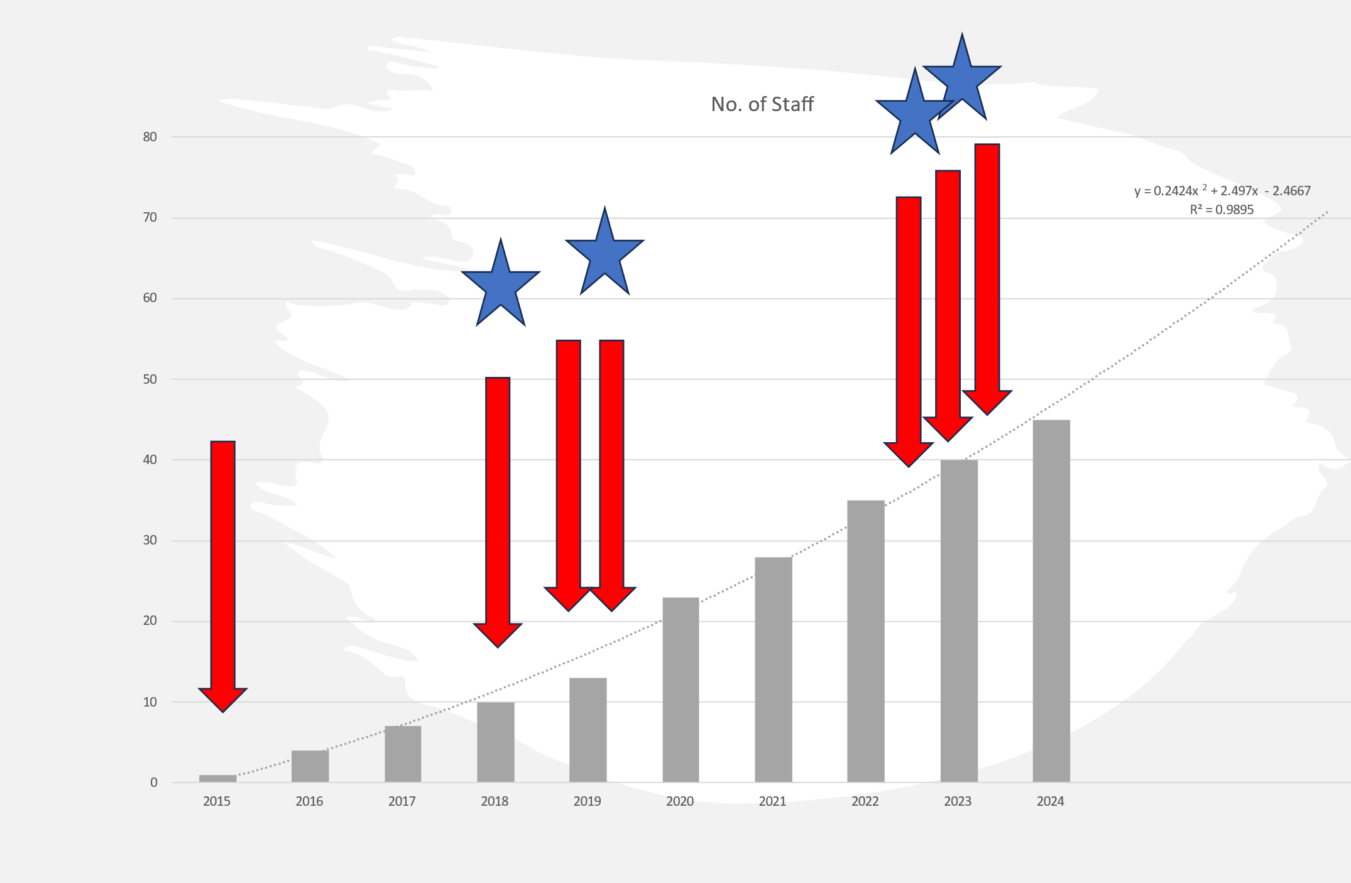
ENV Solutions’ journey
Say hello to your new 2014 Business document

Slide 23
James’ tips
Allocate time: dedicate focused time – rushing leads to overlooked details
Seek assistance: involve your team or an outsider for fresh perspectives and proofreading
Leverage AI Tools: eg ChatGP can help BUT humanize it!
Say hello to your new 2014 Business document

Slide 24
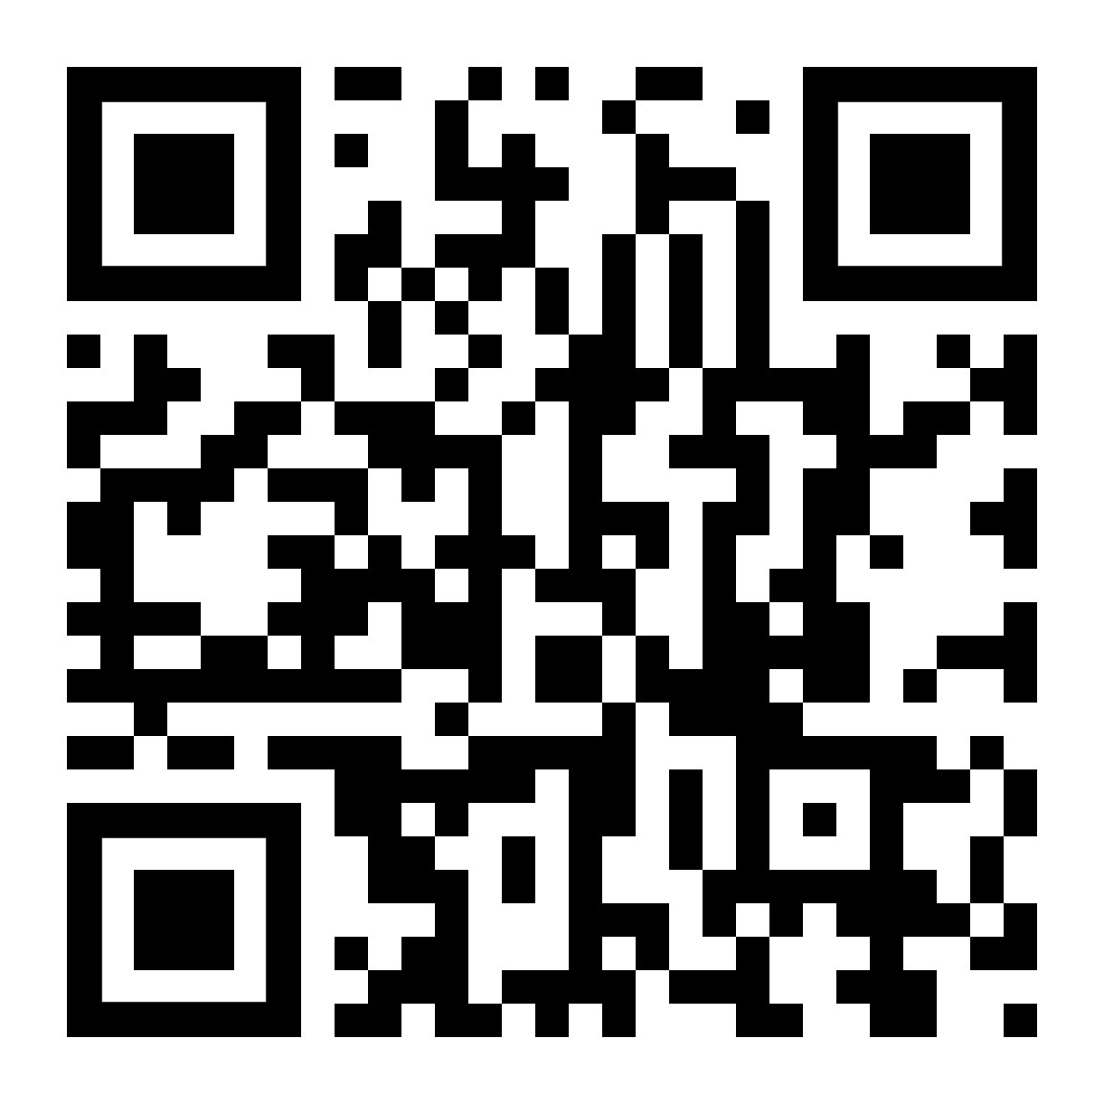
GRANTGURU
Join LCC’s GRANTGURU Hub
Lismore City Council website
https://www.lismore.nsw.gov.au/Business/Business-support/Business-grants
Explore current grant opportunities and register for alerts at the Lismore Grants Hub.
Bullet point one here. over one line but you can extend it if you wish.
Bullet point 2 here.
Bullet point 3 can go here.
Even more Bullet points can be added also.

Slide 25
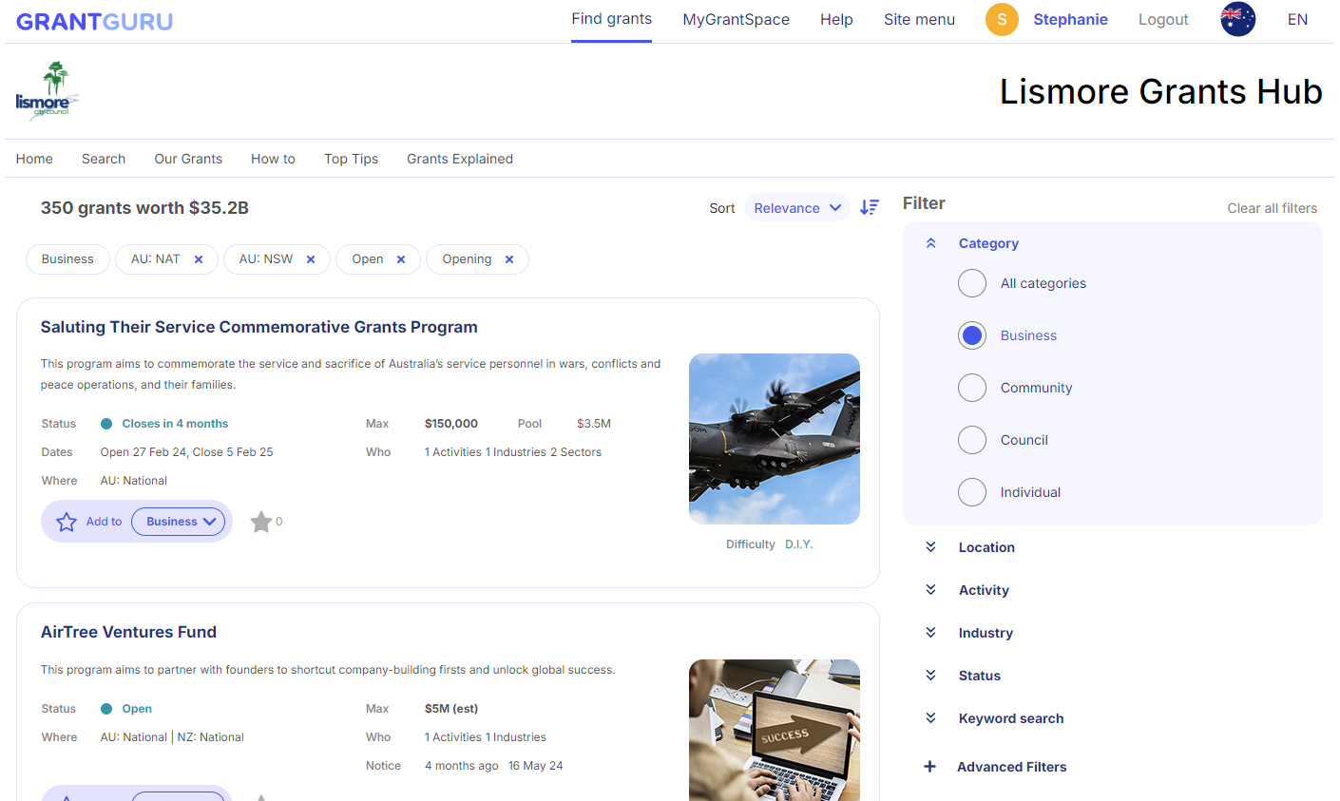
Bullet point one here. over one line but you can extend it if you wish.
Bullet point 2 here.
Bullet point 3 can go here.
Even more Bullet points can be added also.

Slide 26
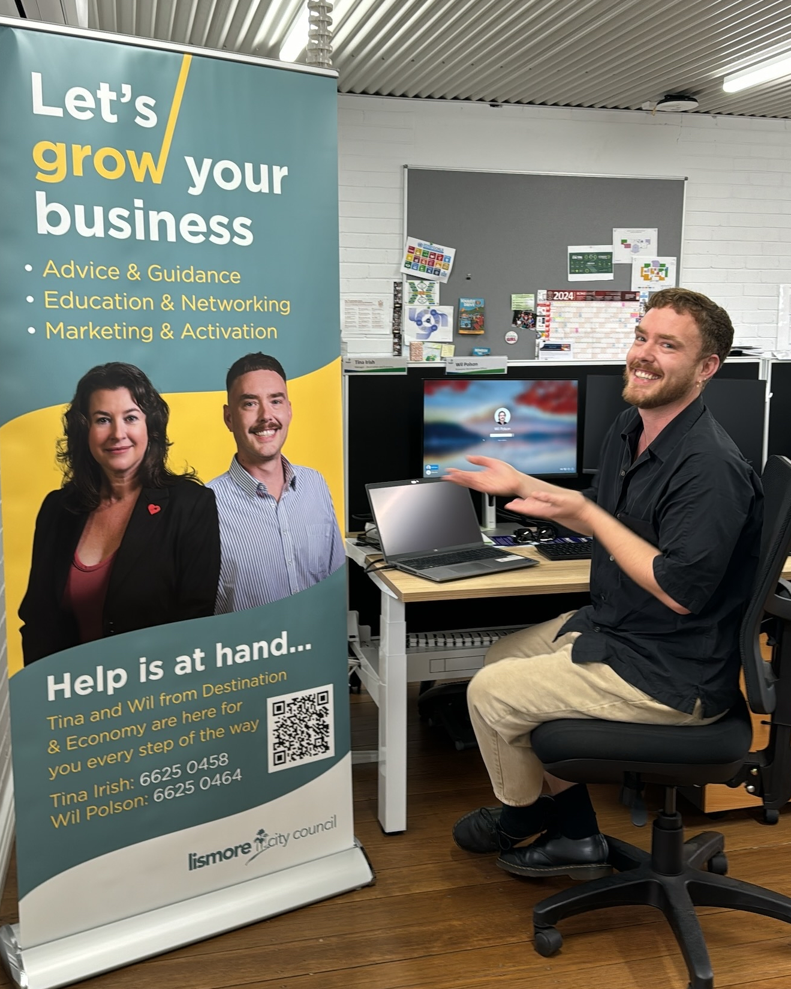
We’re here to help!
Subscribe to LCC’s Business News
https://www.lismore.nsw.gov.au/Business/Business-support/Business-newsletters
Bullet point one here. over one line but you can extend it if you wish.
Bullet point 2 here.
Bullet point 3 can go here.
Even more Bullet points can be added also.
Letters of support from Council
when projects align with operational plans, Policies Strategies
notice is required
business@lismore.nsw.gov.au

Slide 27
Questions?
Bullet point one here. over one line but you can extend it if you wish.
Bullet point 2 here.
Bullet point 3 can go here.
Even more Bullet points can be added also.
Thank you for participating!
With each grant application there is new wisdom and new lessons learned. Whether funded or denied, it serves to make our next application
that much stronger!

Slide 28
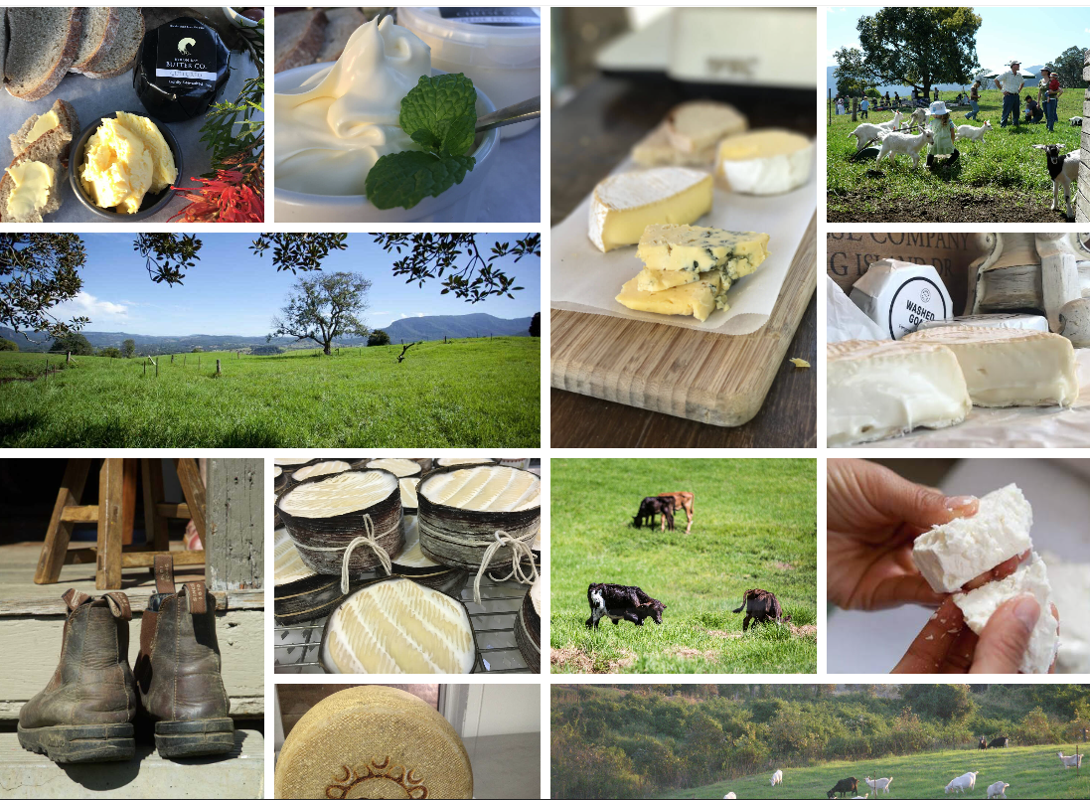
Nimbin Valley Diary
Bullet point one here. over one line but you can extend it if you wish.
Bullet point 2 here.
Bullet point 3 can go here.
Even more Bullet points can be added also.

